Slide 1


Regional Movie Trends Analysis Across India
Batch no:324
Team Members:
1.Kandukuri Jaswanth
2. Paramkusam divya teja

Slide 2
About me
Background:
Kandukuri Jaswanth
I recently graduated with a B.Tech in Information Technology from Gokaraju Rangaraju Institute of Engineering and Technology. My academic background in programming, algorithms, cloud computing with AWS, and data analysis has fueled my interest in data analytics. I’ve completed internships with AICTE in AWS Cloud and AI-ML, gaining hands-on experience in cloud infrastructure, deployment, and real-time data processing. Additionally, I led a team at Unschool and hosted a static website on AWS. I am passionate about leveraging data analytics to drive insights and solutions.
Linkedin: https://www.linkedin.com/in/kandukuri-jaswanth-61a8a2209/
github: https://github.com/KandukuriJaswanth
Paramkusam divya teja
I graduated 2019 with bsc computers in Viswa Bharathi degree college.my academic background in programming ,algorithms,html , c,c++, web developing.and I worked has as customer executive in Agies company.

Slide 3
Agenda
Business Problem and Use case domain understanding
The Indian film industry, with distinct regional variations, demonstrates unique audience preferences and box office performance across South India, North India, Western India, Central India, and East India. Genres and violent themes dominate in many regions, while Indian dramas and army-themed films face challenges, particularly in South India and parts of East India. Audience appeal often supersedes critical ratings, with the 14-35 age group playing a crucial role in a film's success. The industry is progressively shifting towards action-driven, gritty narratives, reflecting changing tastes across various regions, moving away from traditional drama-based storytelling.

Slide 4
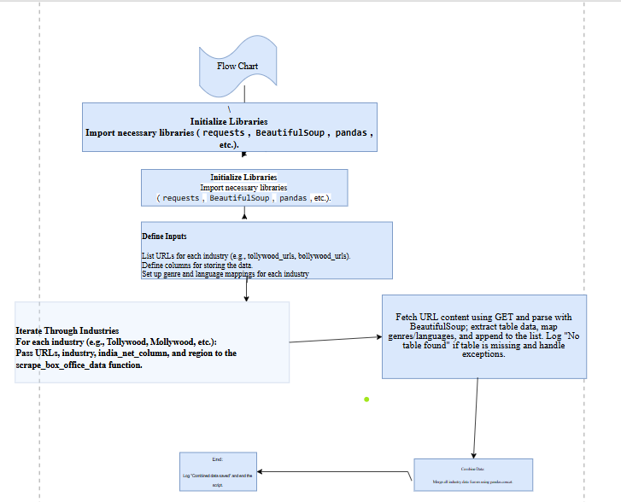
Project Objective
The project aims to analyze the performance of movies across various languages and regions, including Telugu, Malayalam, Hindi, Marathi, Gujarati, and Bengali films, focusing on metrics like box office earnings, budgets, genres, and verdicts. While Telugu audiences have recently shown a stronger preference for action and adventure movies over comedy or real-life stories, other industries like Hindi and Bengali have embraced comedy and biographical narratives more successfully. Despite this, the Telugu film industry continues to outshine others with remarkable box office success across genres.
Web Scraping
The web scraping process is carried out for various URLs corresponding to different industries and years. After extracting the box office data, it is compiled into a single DataFrame. This DataFrame aggregates the box office information from multiple regions and years, offering a comprehensive overview of the data across different industries.

Slide 5
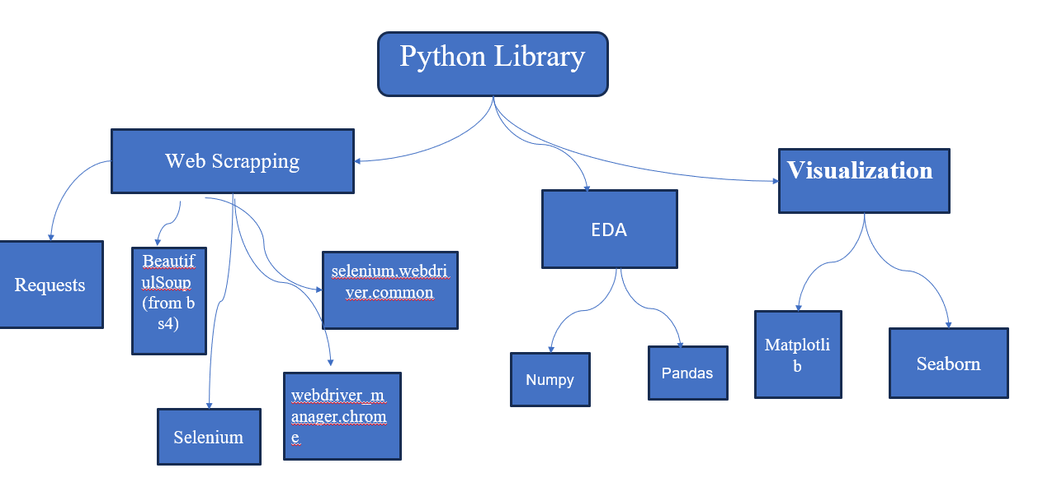
Python Libraries

Slide 6
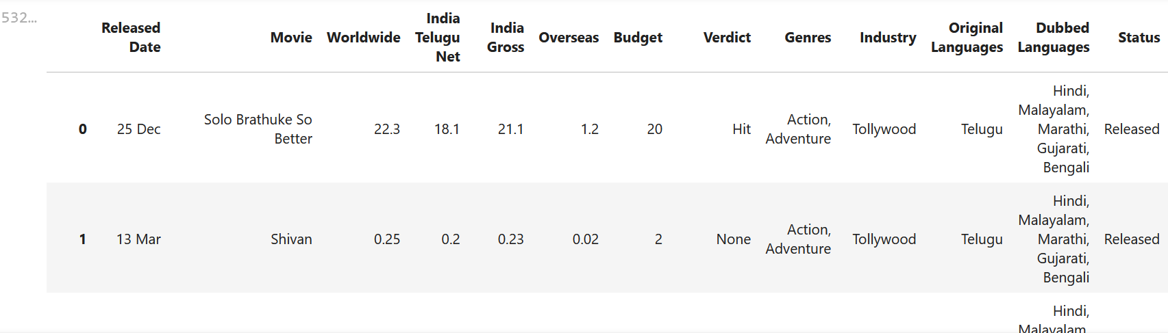
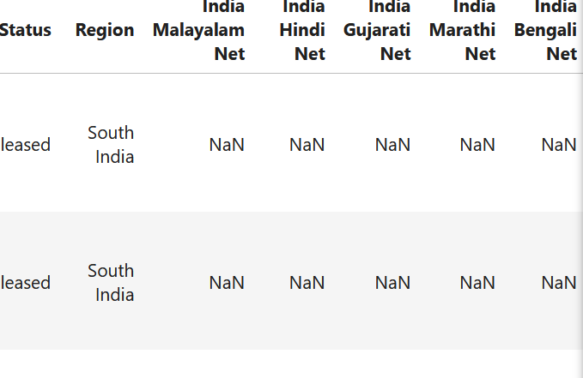
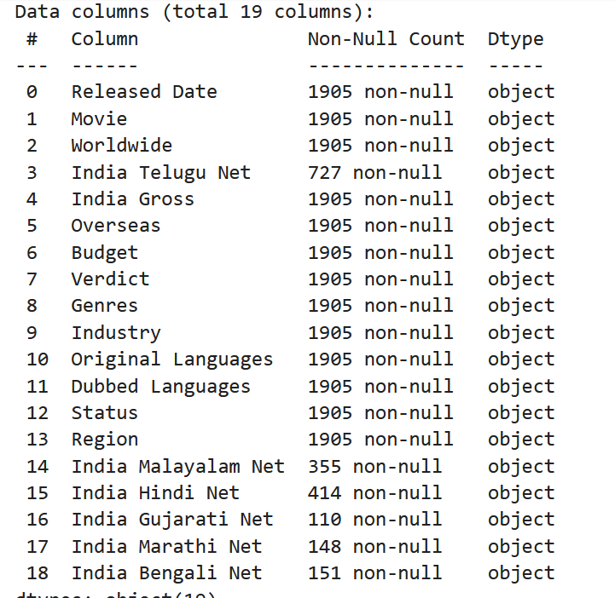
DATA EXTRACTION
DATA Overview
Data Source: Sacnilk Movies Data Description: Extracted 1,904 rows and 19 features.

Slide 7
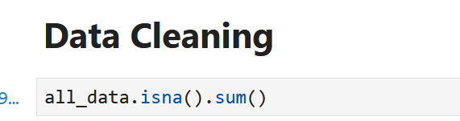
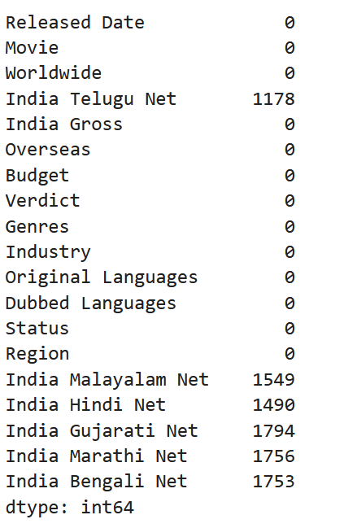
Exploratory Data Analysis
Data Exploration:
Exploratory Data Analysis
Data Cleaning
Conduct Data Quality Assessment
The dataset contains missing values in several columns, such as India Telugu Net, India Malayalam Net, and India Hindi Net. These gaps may represent missing financial or regional data. Addressing missing data is essential to ensure accurate analysis. Possible solutions include filling missing values with the median or mean, using forward/backward filling, or removing rows with missing data, based on context.
Missing Values
Eliminate Duplicate Records
Identify and Correct Inconsistencies
Convert Data Types
Statistical Summary

Slide 8
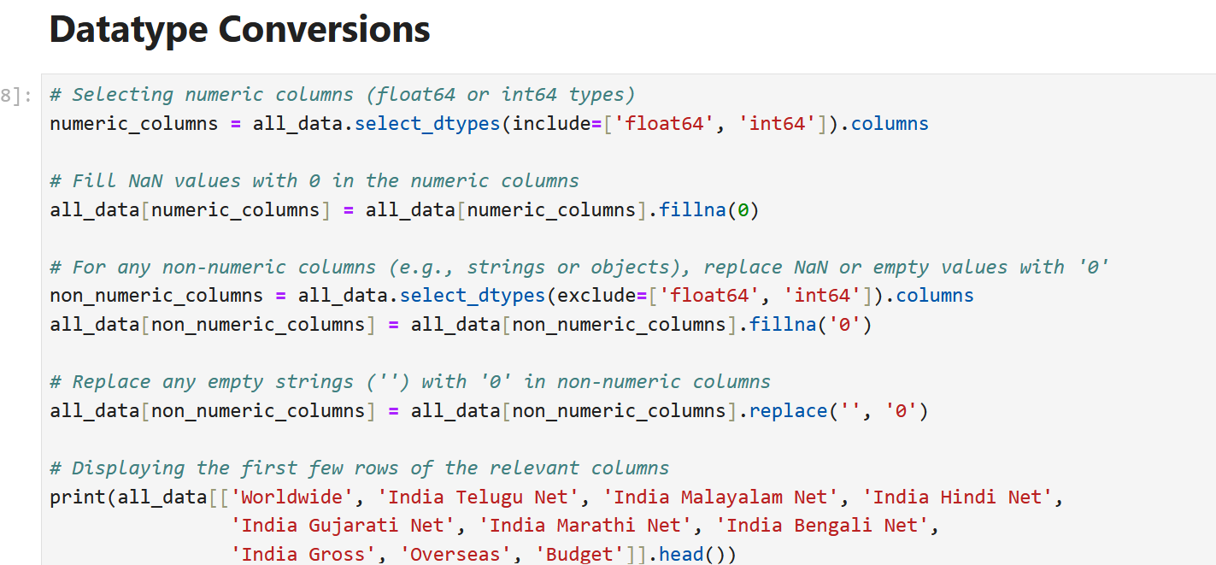
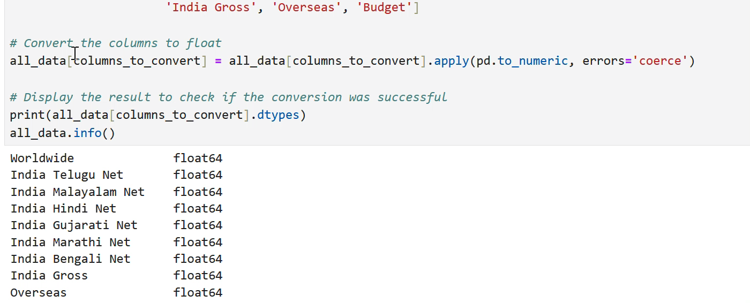
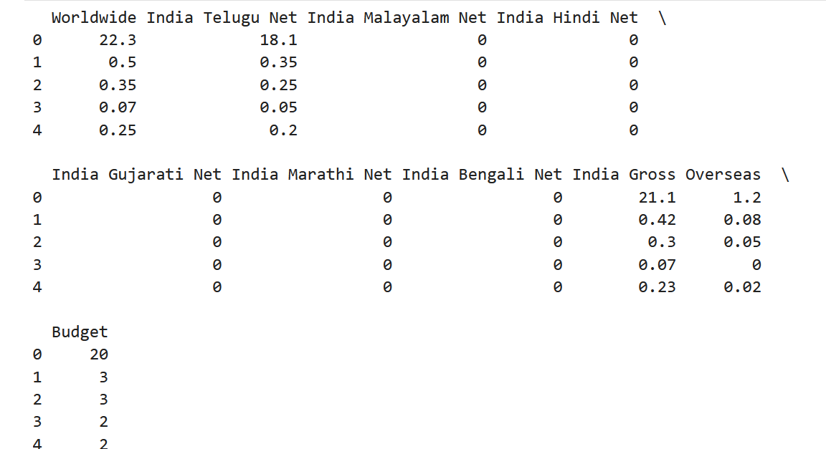
Methods and Potential Errors
Correct Method
In data cleaning, missing values in columns like 'Worldwide', 'India Telugu Net', and 'Budget' are replaced with zero to preserve existing data. Identifying dubbed languages is essential for accurate analysis.

Slide 9
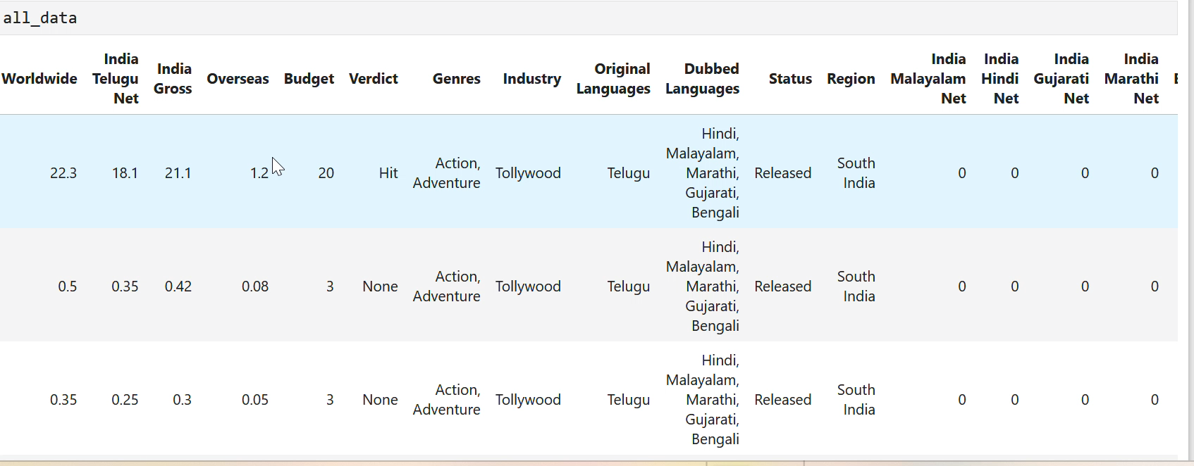
Sanitized Data

Slide 10
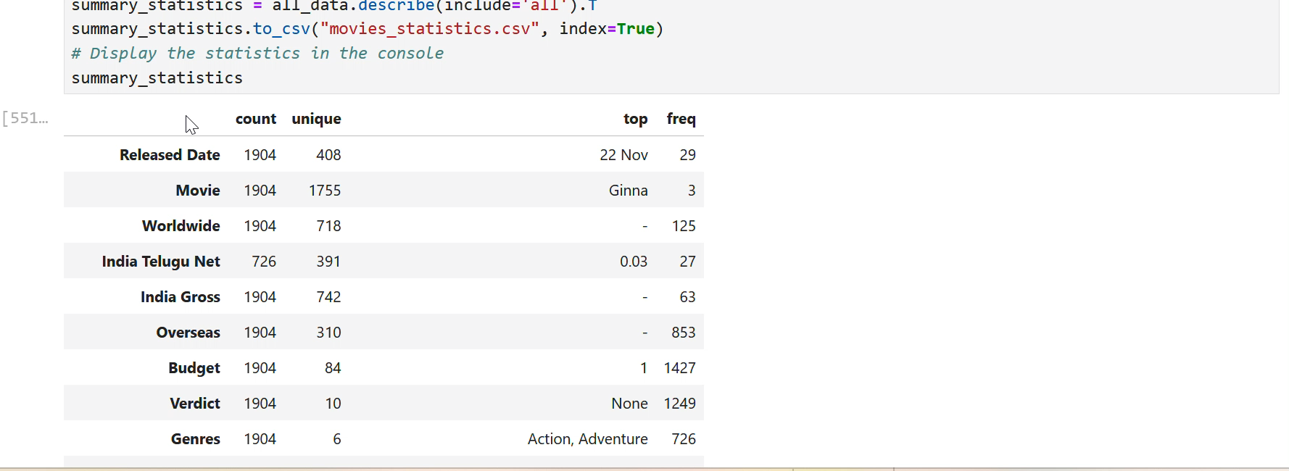
Data Transformation
EDA
Data Transformation
Data Selection and Ordering
Aggregation
The statistical analysis reveals insights into data distribution, including variance, covariance, correlation, mode, range, and quartiles. Outliers are detected using the IQR method, aiding in understanding data variability and trends.

Slide 11
Data Visualization
Exploratory Data Analysis
Data Visualization
Univariate Analysis
Bivariate Analysis
Multivariate Analysis

Slide 12
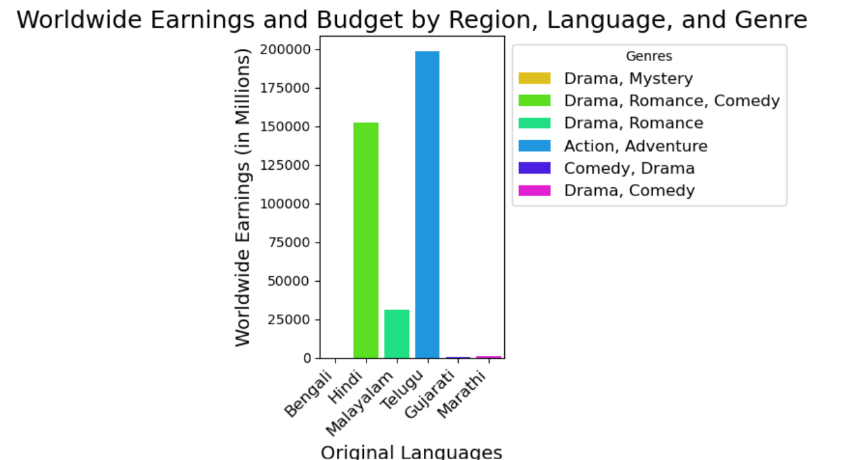
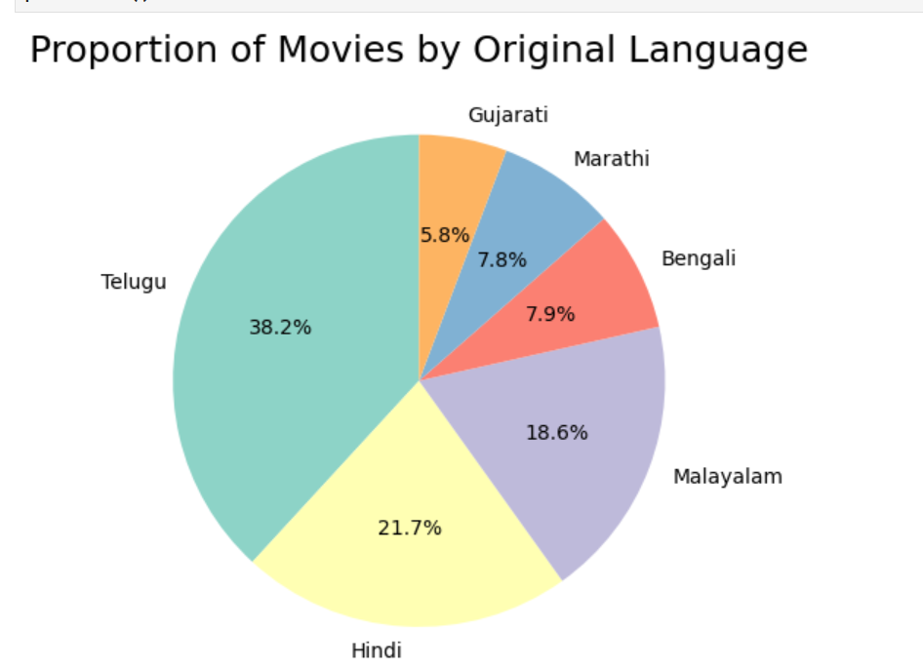
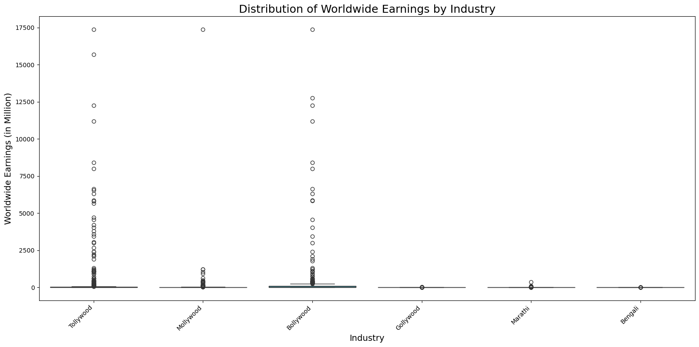
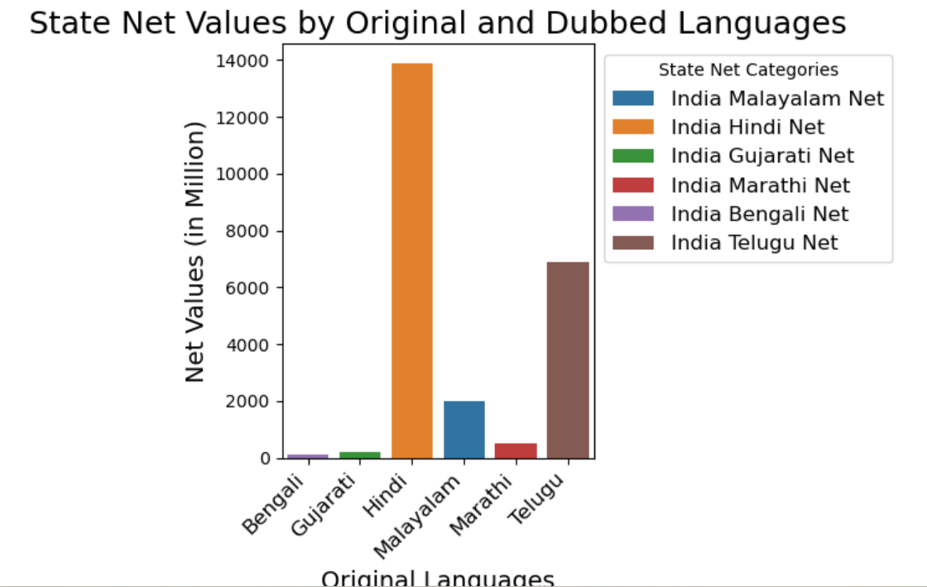
Data Visualization
Univariate Analysis
Worldwide Earnings and Budget by Region and Language, Genres
Insights: Analyzes worldwide earnings across regions, languages, and genres, identifying top-performing genres regionally.
Net Earnings by State for Original vs. Dubbed Languages
Insights: Compares earnings by state, showing regional preferences for dubbed or original language films.
Distribution and Density of Overseas Earnings by Movie Status
Insights: Shows how hit movies outperform flops overseas, highlighting earnings distribution by movie status.

Slide 13
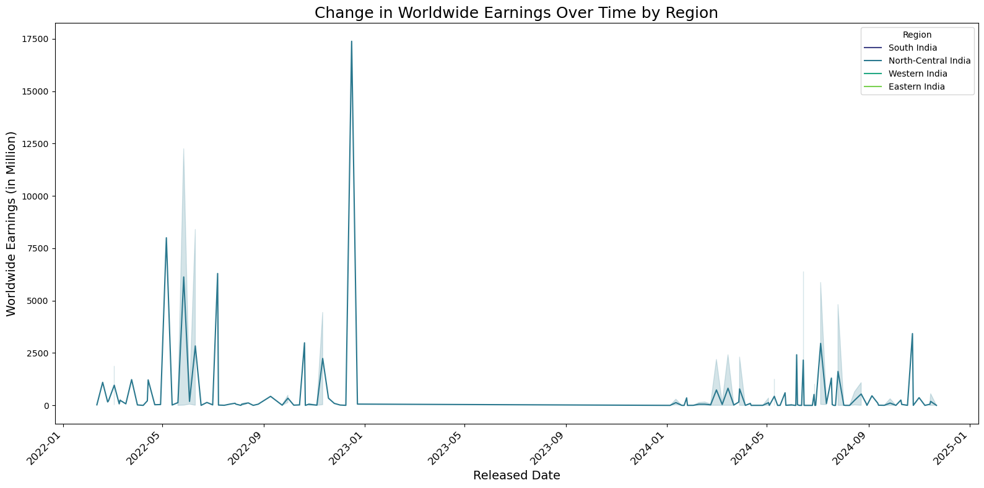
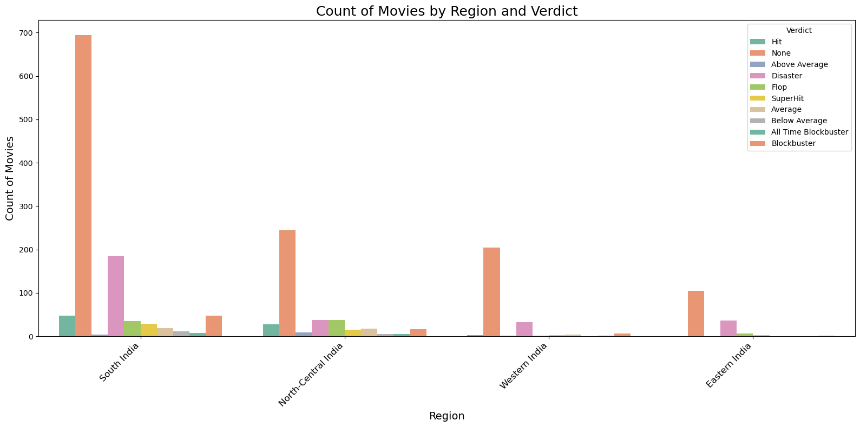
Bivariate Analysis
Evolution of Worldwide Earnings Over Time by Region
Insights: Tracks regional earnings trends, highlighting areas with growth or decline and the impact of global factors like pandemics or new technologies.
Movie Count by Region and Verdict
Insights: Identifies regions with high success rates and those that experience more frequent flops.

Slide 14
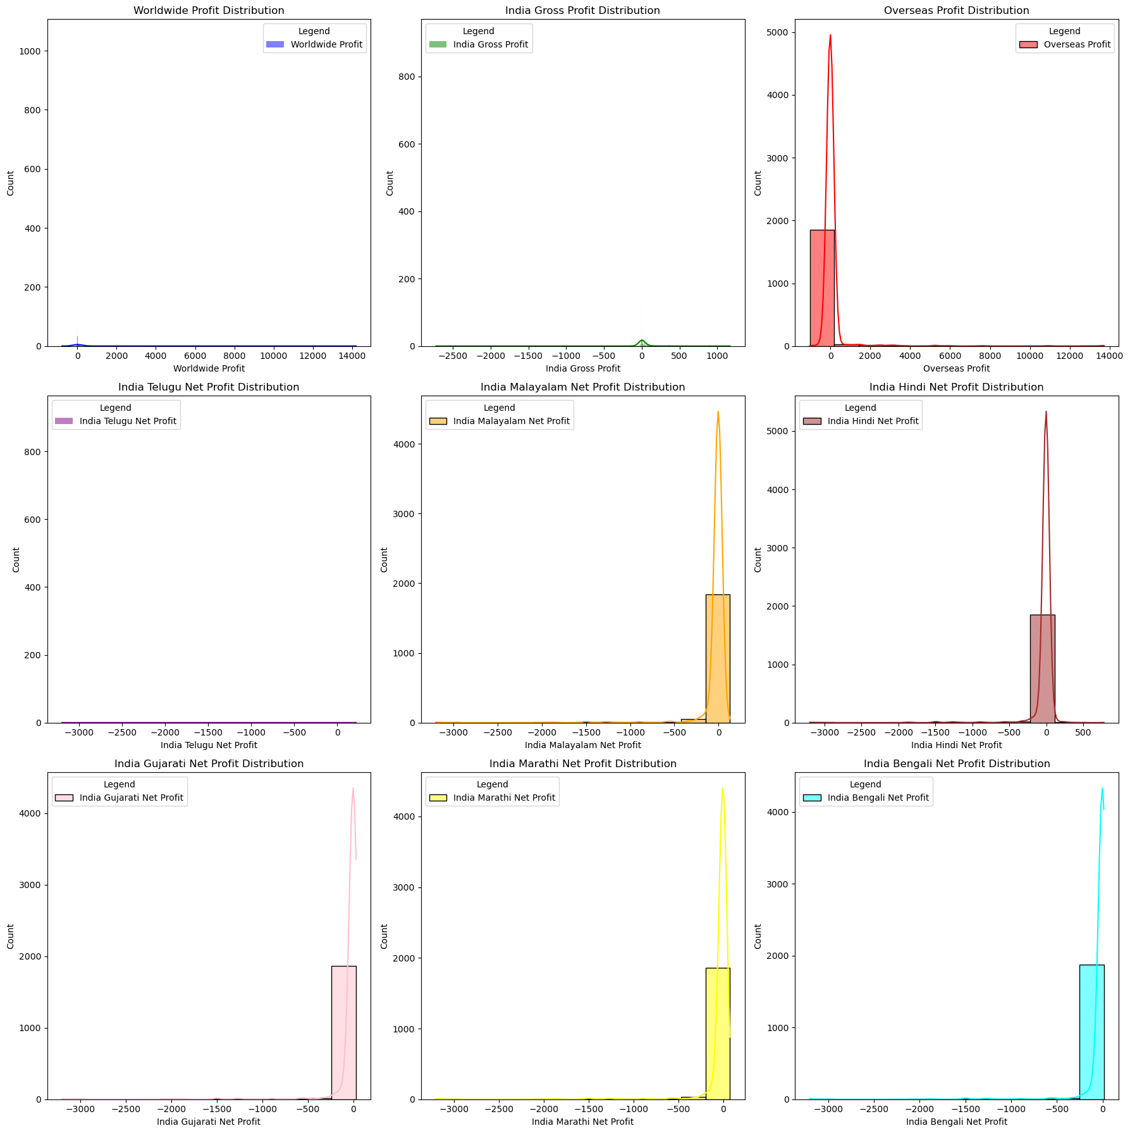
Multivariate Analysis
The analysis of movie profits across different categories (Worldwide, India Gross, Overseas, and regional profits) uncovers varied profitability trends influenced by language and industry. Regional markets, particularly India Telugu and Malayalam, exhibit unique profit patterns, emphasizing the significance of localization in optimizing revenue.

Slide 15
Conclusion
The analysis of movie earnings offers valuable insights into regional preferences, genre performance, and the influence of language localization. It highlights how certain genres perform better in specific regions, while dubbed versions significantly enhance earnings in diverse markets. The relationship between budget and earnings underscores the importance of making strategic investments in film production. The correlation analysis further identifies key factors driving financial success, offering a deeper understanding of what contributes to a movie’s profitability. By examining trends across industries, movie statuses, and language preferences, the findings provide a comprehensive view of evolving audience behavior. This helps identify profitable strategies for movie production, distribution, and marketing, optimizing decision-making in the entertainment industry.

Slide 16

THANK YOU

